Slide 1
Building highly available, secure, and scalable services for the enterprise with Azure Networking
BRK4028
Amit Srivastava
Christian Kuhtz
Dilip Lukose
Azure Networking
Michael Shavell
Symantec

Slide 2



Session overview
  Learn how to build reliability, scale, and security into your scenario
  Understand when and where to use Azure load balancing abilities
  Know what is new in load balancing for Azure
  SESSION OBJECTIVE(S)

Slide 3


Why Load Balancing?
Define well known endpoints for your customers
Assure, scale, and secure your applications
Simplify scenarios with fully managed products
Load Balancer
Traffic Manager
Application Gateway
aka.ms/lbpreview
aka.ms/trafficmanager
aka.ms/appgw

Slide 4







Load balancing scenarios
DNS
Traffic
Manager
Load Balancer
Application Gateway / WAF
Load Balancer
DB
DB
DB
DB
DB
DB
DB
DB
REGION A
REGION B
Scalable
Redundant
Scalable
Redundant
+ Protection
+ Global
with multiple
Azure Regions

Slide 5
What’s New?
  Load Balancer
  New Load Balancer, SKUs
  Pool up to 1000 instances in VNet, incl. 1000 instance VMSS
  Multiple VMSS
  Zone-redundant data path with single IP
  Zonal frontends
  Cross-zone load balancing
  Cross-zone VMSS
  HA Ports for NVAs and more
  Advanced analytics (Traffic Counters, Per Endpoint health probe status, Continuous in-band data plane health, Inbound connection attempts, Outbound connections)
  Application Gateway
  SSL Policy with cipher suites
  Redirection
  Multitenant (WebApp) backend
  Health probe enhancements
  Multiple VMSS
  Path override
  Idle timeout and domain label
  WAF: OWASP ModSecurity CRS 3.0
  WAF: Rule configurability
  WAF ASC and OMS log analytics
  Traffic Manager
  Real User Measurements
  Traffic Flow
  EDNS Client Subnet
  Azure Monitor Metrics
  Fast Failover
  Geographic Routing

Slide 6
Load Balancer

Slide 7

Load Balancer
3 Fundamental Scenarios
Part of the Azure SDN stack
High performance & low latency for all TCP & UDP applications
Flow-based Load Balancing
with Health Probing
Inbound NAT rules
Outbound Connections
Public IP
Address
Private IP
Address
Public IP
Address
Public
Load Balancer
Internal
Load Balancer
Outbound connections

Slide 8

Announcing: Load Balancer Standard (Preview)
Expands to your entire VNet
(with or without Availability Sets)
Up to 1000 instances in backend pool
(includes 1000 instance VMSS)
HA Ports
Balance and scale virtual appliances, and more
Advanced analytics
Availability Zones:
Cross-zone load balancing
Zone-redundant LB
Zone-redundant data path
(regional anycast, public & internal, inbound & out)
Load Balancer
Standard
Zonal VM
Zonal VM
Zonal VM
Zone 1
Zone 2
Zone 3

Slide 9

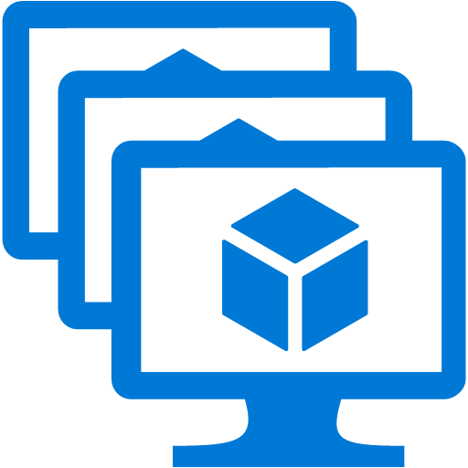
Expands to entire VNet
Load Balancer Standard
VNet
Load Balancer no longer uses Availability Set as a boundary for the backend pool
Standalone VMs without Availability Sets
Standalone VMs with Availability Sets
Virtual machine scale sets with up to 1000 instances
Cross-zone VMSS https://aka.ms/xzonevmss
Multiple VMSS
Blending VMs and virtual machine scale sets
VM scale set
VM scale set
VM scale set
Zone 1
Zone 2
Zone 3
Load Balancer Standard
VNet
Network Security Groups are required for Public IP and all backend instances
Explicit whitelist for traffic you want to permit
VM Scale Set (coming soon)
Zone 1
Zone 2
Zone 3

Slide 10
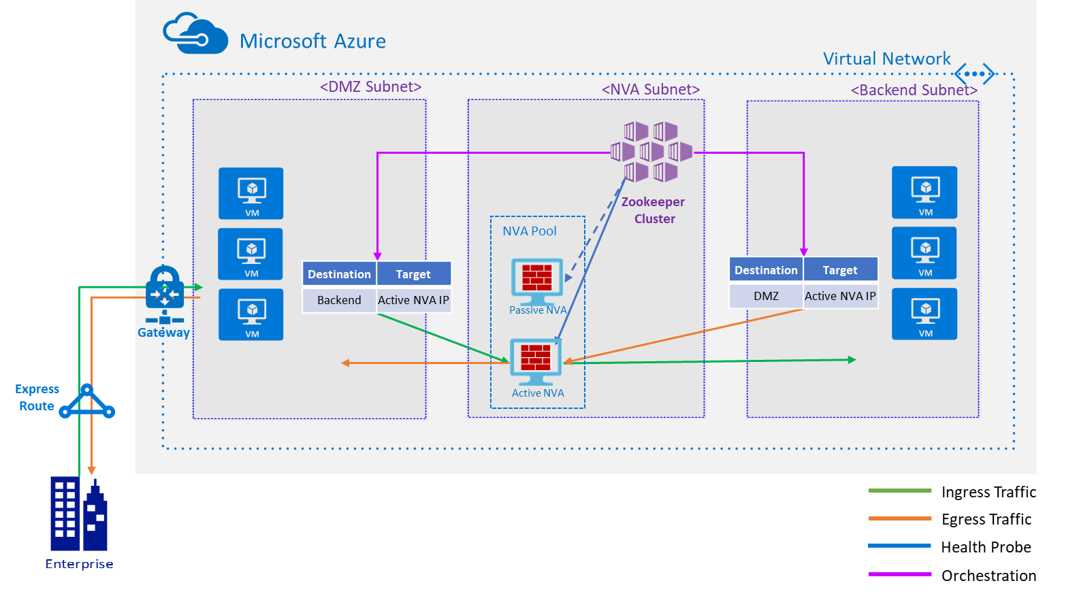
Virtual Appliance resiliency is difficult today
Complicated and Limited

Slide 11
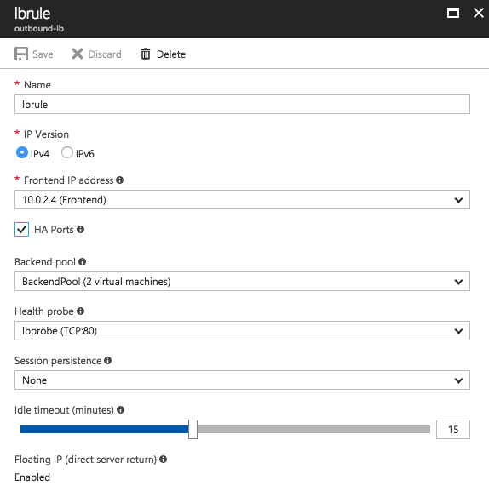
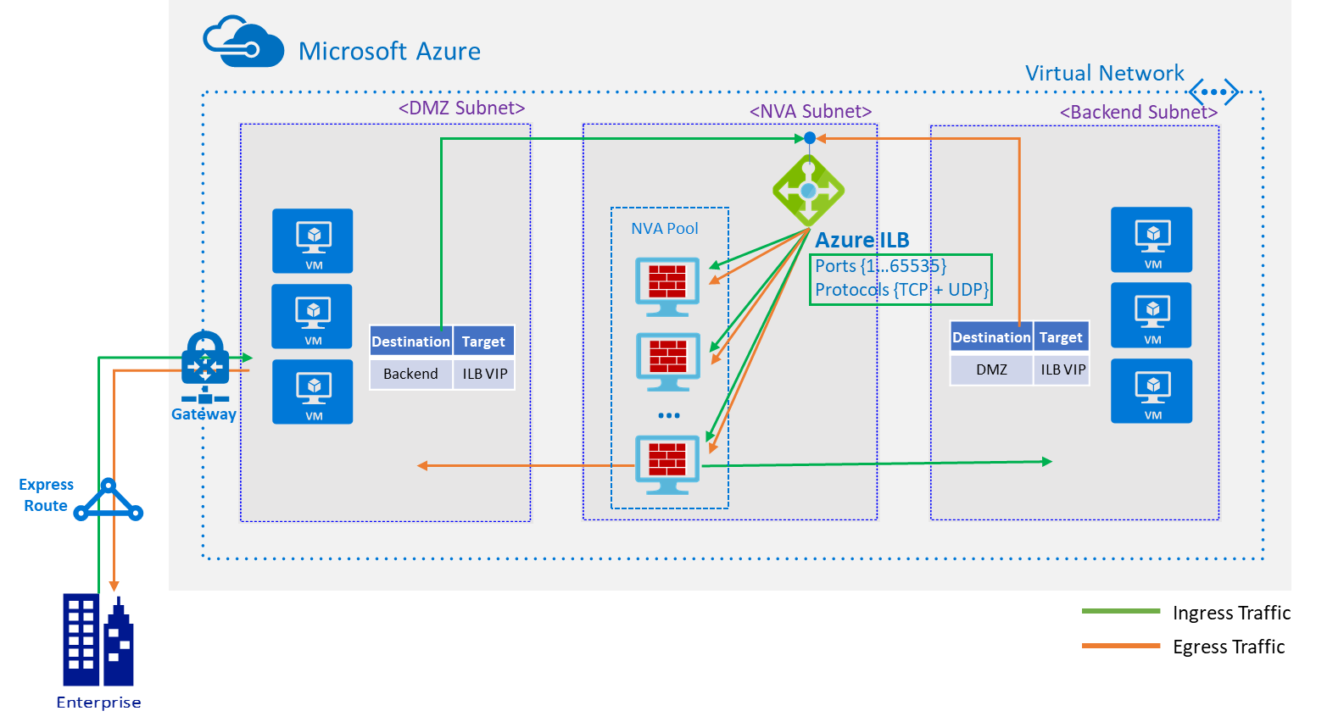
Reference Architecture: NVA with HA Ports
Simple, Reliable, Intuitive

Slide 12
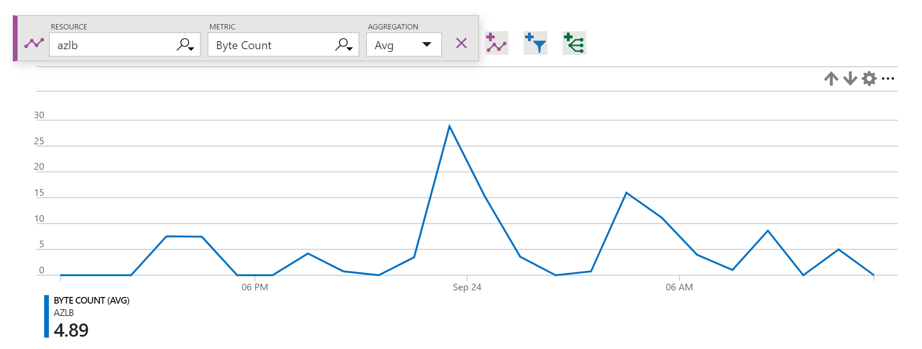
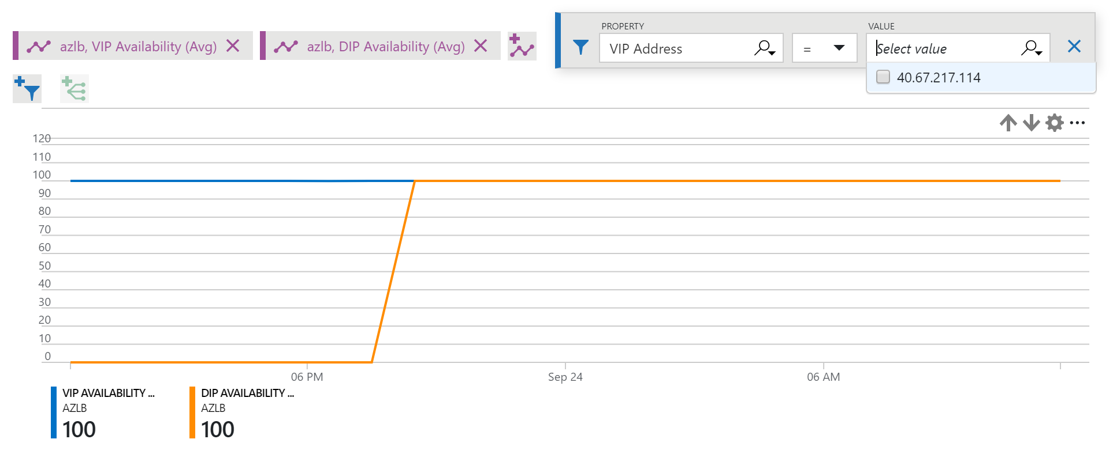
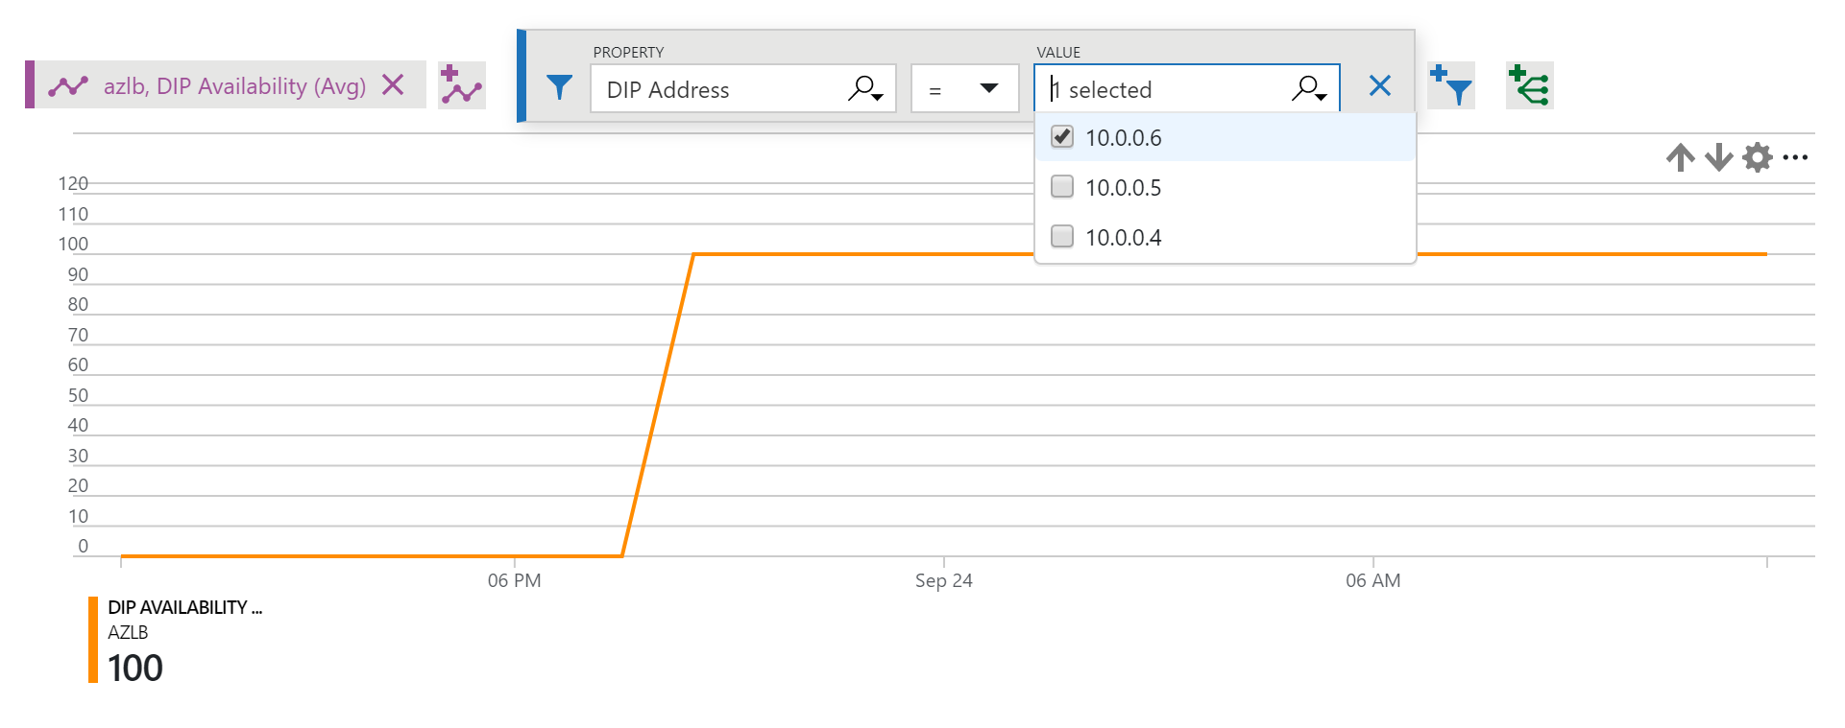
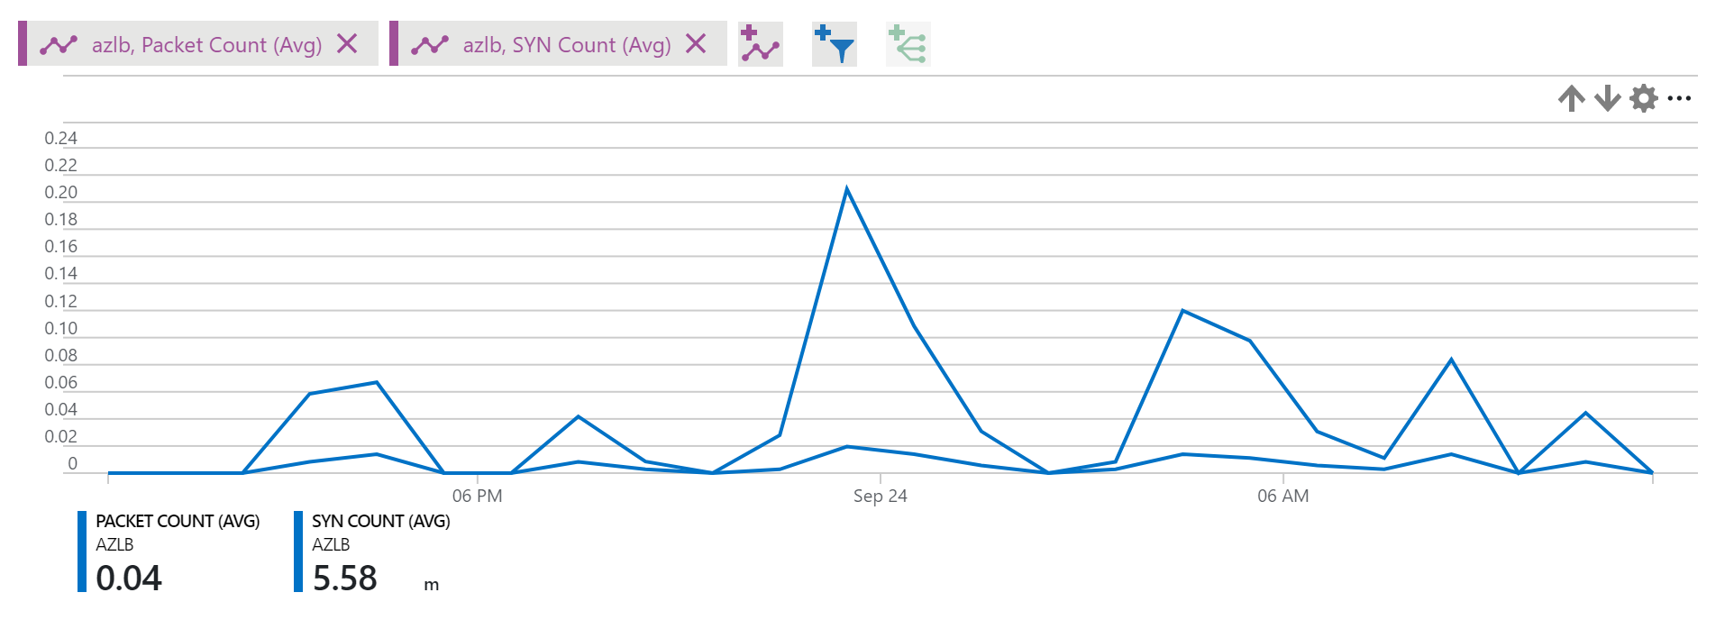
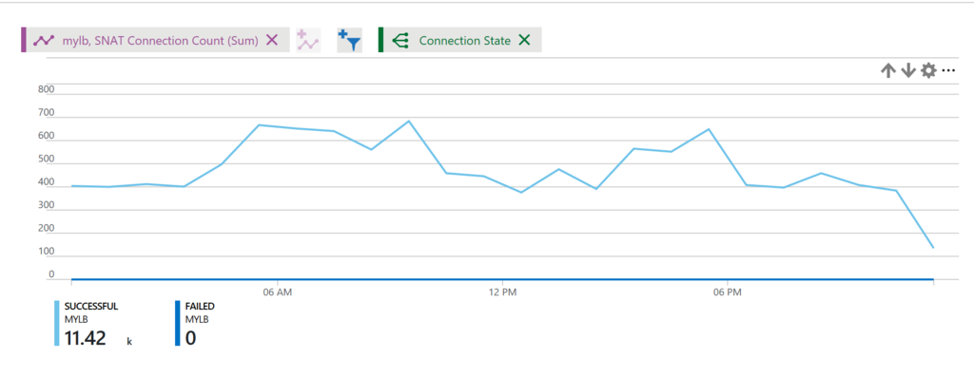

Advanced Analytics
Bytes, Packets
Continuous data plane health
Per instance health probe status
Outbound connections
Inbound connection attempts
Traffic counters
TCP SYNs
Health probe
Data plane health
New multi-dimensional metrics
Select, filter, and group
Fully integrated with Azure Monitor
SNAT connections

Slide 13
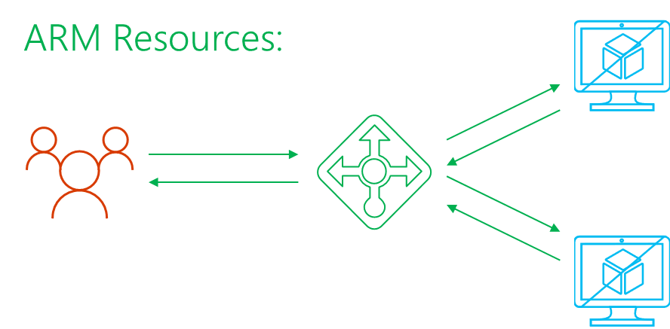


Understand data plane health
New continuous measurement of data plane health
In-band to all defined endpoints
Invisible to application
Azure LB
MUX Service
VSwitch
Azure LB
Probing
Service
Hypervisor
VSwitch
Hypervisor

Slide 14
Outbound connections (SNAT)
Translation from private to public IP address
Ports of public IP address are used to make connections unique
Many connections to same destination can exhaust SNAT ports
Public IP
Address
Use Monitor telemetry!
Mitigation:
Reuse connections
Assign Public IP’s directly to VM’s (Instance-Level Public IP)
Outbound connections

Slide 15
SKUs for Load Balancer & Public IP (ARM)
API version
2017-08-01
LB Standard
LB (Basic)
Load Balancer Resource
{
"apiVersion": "2017-08-01",
{
"type": "Microsoft.Network/loadBalancers",
"name": "[variables('loadBalancerName')]",
"location": "[resourceGroup().location]",
"sku": {
"name": "Standard"
},
[Frontend IP configuration]
[LB rule]
[Probe]
[inbound NAT rule]
[Backend Pool]
}
Load Balancer Resource
{
"apiVersion": "2017-08-01",
{
"type": "Microsoft.Network/loadBalancers",
"name": "[variables('loadBalancerName')]",
"location": "[resourceGroup().location]",
[Frontend IP configuration]
[LB rule]
[Probe]
[inbound NAT rule]
[Backend Pool]
}
Same SKU for public IP
You must use matching SKUs for LB & Public IP
"sku": {
"name": “Basic"
},

Slide 16
Reference Architecture : Web App with AZs
Zone-redundant Load Balancer Standard balances across web frontends with single frontend IP
Web frontend across 3 AZs
Data layer across 3 AZs
  SQL on IaaS
  SQL Azure or CosmosDB
  NoSQL (Cassandra, MongoDB)
Load Balancer Standard
VNet
Zone 1
Zone 2
Zone 3
Web App
Web App
Web App
Front End Subnet
SQL
SQL
SQL
DB Subnet

Slide 17
ARM Template—Cross-Zone VMSS and LB
Add the Compute Resource:
{
"apiVersion": "2017-03-30",
"type": "Microsoft.Compute/virtualMachineScaleSets",
"name": "[parameters('vmssName')]",
"zones" : ["1","2","3"],
"location": "[resourceGroup().location]",
"dependsOn": [
...
],
"sku": {
...
},
"properties": {
...
},
}
Add the Public IP Resource:
{
"apiVersion": "2017-08-01“,
"type":"Microsoft.Network/publicIPAddresses",
"name": "[variables('publicIPAddressName')]",
"location": "[resourceGroup().location]",
"sku": {
"name": "Standard"
},
"properties": {
...
}
}
},
Add the LB Resource:
{
"apiVersion": "2017-08-01",
{
"type": "Microsoft.Network/loadBalancers",
"name": "[variables('loadBalancerName')]",
"location": "[resourceGroup().location]",
"sku": {
"name": "Standard"
},
}

Slide 18

ARM Template—Zonal VM
Add the Compute Resource:
{
"apiVersion": "2017-03-30",
"type": "Microsoft.Compute/virtualMachines",
"name": "[variables('vmName')]",
"location": "[resourceGroup().location]",
"zones": ["1"],
"dependsOn": [
...
],
"properties": {
"hardwareProfile": {
"vmSize": "[parameters('vmSize')]"
},
"osProfile": {
...
},
}
}
Add the Managed Disk Resource:
{
"apiVersion": "2017-03-30",
"type": "Microsoft.Compute/disks",
"name": "myManagedDataDisk",
"location": "[resourceGroup().location]",
"zones": ["1"],
"properties":
{
"creationData":
{
"createOption": "Empty"
},
"accountType :"[parameters('storageAccountType')]",
"diskSizeGB": 64
}
}
Add the ILPIP Resource:
{
"apiVersion": "2017-08-01",
"type": "Microsoft.Network/publicIPAddresses",
"name": "[variables('publicIPAddressName')]",
"location": "[resourceGroup().location]",
"sku": {
"name": "Standard"
},
"properties": {
"publicIPAllocationMethod": “Dynamic",
"dnsSettings": {
"domainNameLabel": "[parameters('dnsLabelPrefix')]"
}
}
}

Slide 19
Demo
Load Balancer Standard & Availability Zones

Slide 20
Scenario
Load Balancer Standard
3x standalone VM’s, one per Zone
Public IP
Standard
Load Balancer
Standard
VNet
Zone 1
Zone 2
Zone 3

Slide 21
Takeaways
Preview
GA
You can use
Load Balancer Standard
for TCP & UDP scenarios with:
Larger scale
Greater flexibility
HA Ports
New metrics
Availability zones
Standard
Up to 1000 backend instances
Zone-redundant frontend Zonal frontend
Availability Sets not required and Availability Zones
Integrated Frontend and Backend health metrics
Supports HA Ports
NSG required
Charged at GA
Basic
Up to 100 backend instances
Non-zonal frontend
Availability Set (single)
Basic NAT and Probe health status
-
NSG optional
Free
vs.

Slide 22
Go to aka.ms/lbpreview
Available Now in 6 regions:
East US 2
Central US
West Central US
West Europe
North Europe
Southeast Asia
+ Availability Zones Preview
+ Availability Zones Preview

Slide 23
Load balancing scenarios
DNS
Traffic
Manager
Load Balancer
Application Gateway / WAF
Load Balancer
DB
DB
DB
DB
DB
DB
DB
DB
REGION A
REGION B
Scalable
Redundant
Scalable
Redundant
+ Protection
+ Global
with multiple
Azure Regions

Slide 24
Application Gateway

Slide 25
Application Gateway
OVERVIEW
Level 7 routing
  HTTP round robin
  Cookie based session affinity
  Multi-site hosting
  URL based routing
Security
  SSL termination
  SSL Policy (protocol version and cipher)
  End to end SSL
  Web Application Firewall
Diagnostics and probes
  Rich diagnostics including access and performance logs, WAF logs, backend health log
  Custom health probes
fabrikam.com
Application Gateway
Videos
contoso.com
fabrikam.com
Images
contoso.com/video/*
contoso.com/images/*

Slide 26
Enhanced connectivity
HTTPS
Round robin HTTP load distribution
Backend choices
  VMs via NICs
  Internal IP
  External Public IP
  VMSS
  Azure Web Apps
  Containers
Connectivity Options
  VMs in same VNet
  VMs across connected VNets
  Cloud services
  Hybrid connectivity to on premises VMs
  External servers
VNET 1
Application Gateway
Cloud Service
VM3
VM2
VM1
VNET 2
Cloud Service
On-oremise VM
VM4

Slide 27
SSL management
Whitelist
Backend
Pool 1
SSL termination
Increased web farm productivity
Central SSL management
User configurable SSL policy
  Allow/block SSL protocols
  Ciphers and priority
  SSL probes
End to end SSL encryption
  Secure backend communication
  Enable whitelisting
×
HTTPS TLS1.0
Application
Gateway
VM1
HTTPS
VM2
HTTPS TLS1.1
×
HTTP
HTTPS sslv3
Backend
Pool 2
VM3
VM4

Slide 28
URL routing and multi-site support
fabrikam.com
URL based routing
  Backend pool selection based on request path
  Configure up to 20 backend pools
Multi site support
  Pack up to 20 different domains or subdomains
  Each domain to its own backend pool
  SSL offload via Server Name Indication (SNI)
Application Gateway
Videos
contoso.com
fabrikam.com
Images
contoso.com/video/*
contoso.com/images/*

Slide 29
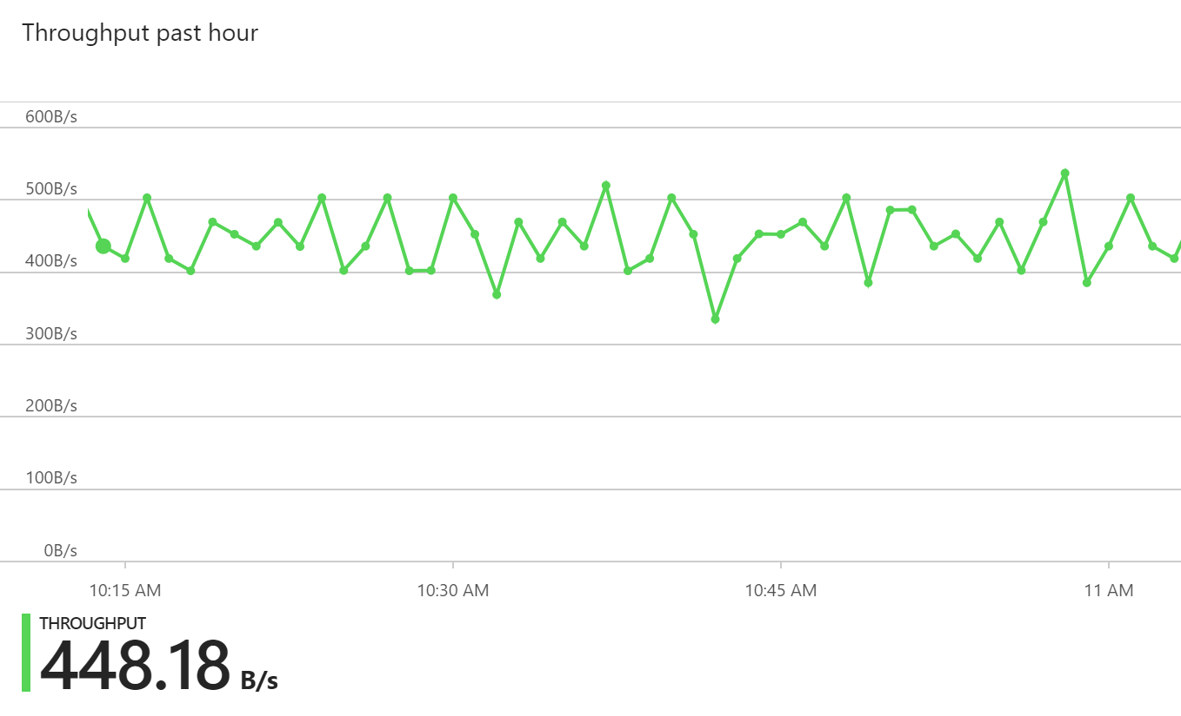
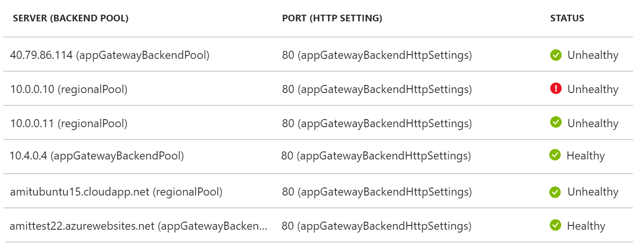
Diagnostics
{
"instanceId":"ApplicationGatewayRole_IN_0",
"clientIP":"37.186.113.170",
"clientPort":"12345",
"httpMethod":"HEAD",
"requestUri":"/xyz/portal",
"requestQuery":"",
"userAgent":"-",
"httpStatus":"200",
"httpVersion":"HTTP/1.0",
"receivedBytes":"27",
"sentBytes":"202",
"timeTaken":"359",
"sslEnabled":"off"
}
Integrated with Azure Monitor
Access logs
  Logs each request/response
  Log frequency every 5 mins
Performance logs
  Logs gateway instance data
  Log frequency every 1 min
WAF logs
Metrics data
  Alerts
  Webjobs
Backend health logs
{
"instanceId":"ApplicationGatewayRole_IN_1",
"healthyHostCount":"4",
"unHealthyHostCount":"0",
"requestCount":"185",
"latency":"0",
"failedRequestCount":"0",
"throughput":"119427"
}

Slide 30
Configurable SSL policy
Control both protocol version and cipher
Harden security at gateway
Compliance
Preconfigured policy
AppGwSslPolicy20170401S
AppGwSslPolicy20170401
AppGwSslPolicy20150501
Custom SSL policy
Specify minProtocolVersion
Specify cipher suites and priority order
NEW
SSL policy: preconfigured
Name: AppGwSslPolicy20170401S
MinProtocolVersion: TLSv1_2
CipherSuites:
TLS_ECDHE_ECDSA_WITH_AES_128_GCM_SHA256
TLS_ECDHE_ECDSA_WITH_AES_256_GCM_SHA384
TLS_ECDHE_ECDSA_WITH_AES_128_CBC_SHA
TLS_ECDHE_ECDSA_WITH_AES_256_CBC_SHA
……
……
SSL policy: custom
Name: CustomPolicy1
MinProtocolVersion: TLSv1_0
CipherSuites:
TLS_RSA_WITH_AES_256_GCM_SHA384
TLS_RSA_WITH_AES_128_GCM_SHA256
TLS_RSA_WITH_AES_256_CBC_SHA256
TLS_RSA_WITH_AES_128_CBC_SHA256
TLS_RSA_WITH_AES_256_CBC_SHA
TLS_RSA_WITH_AES_128_CBC_SHA
……
……

Slide 31
Application Gateway redirection
NEW
Redirect HTTP to HTTPS
Backend pool redirection no longer required
Global redirection for whole site
Redirect on a specific site path
Integrated with URL Path Maps
Redirect Listener to listener
.com to .org redirection
One sub domain to another
subdomain redirection
Redirect to external site
App
Gateway
HTTP
301 redirect
HTTPS

Slide 32
Multi-tenant backend support
NEW
Supports Web App as backend
for WAF and Standard AppGw
Supports public facing Web App deployments and App Service Environment (ASE)
Two modes offered to override
backend host header
Pick host name from FQDN
User supplied host name
Both SSL offload and
end-to-end SSL supported
App
Gateway
Host:contoso11
Host:contoso
Host:contoso22

Slide 33
Custom probes enhancements
Custom probes
  User defined probes
  Probe configured at Backend Settings
  Probing done at VM + port granularity
  Backend health report for VM health and routing decision
  Control probe frequency, timeout, custom URI path, host header
  Enhancements
  Ability to define HTTP response code range
  Ability to inspect response body
service1:80
Backend Pool
Application Gateway
service2:8080
VM1
service2:8080
VM2
service1:8080

Slide 34
Web Application Firewall (WAF)
Site 1
App
Gateway
Valid request
Protect applications from web
based intrusions
Highly available, scalable, fully
platform managed
Built using popular ModSecurity Core Rule Set
CRS 2.2.9
CRS 3.0
Preconfigured rule set for baseline protection from OWASP top 10 vulnerabilities
SQL Injection
XSS attacks
XSS attack
WAF
Site 2
Valid request
Valid request
SQL injection
L7 LB

Slide 35
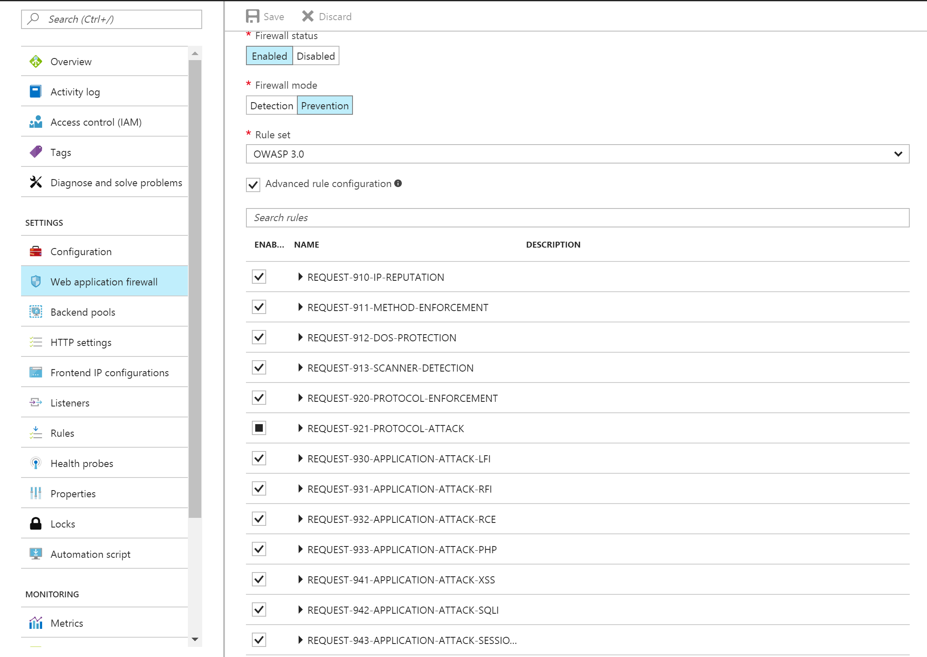
WAF preconfigured rules
RuleSet offered:
CRS 2.2.9
CRS 3.0
Protect from:
SQL Injection
Cross site scripting
Protocol violations
Generic attacks
HTTP rate limiting
Scanner detection
Session fixation
LFI/RFI

Slide 36
WAF user configurable rules
Rule configurability
Prevention/Detection modes
Change RuleSet CRS 2.2.9 or CRS 3.0
Enable or Disable entire RuleGroups
Enable or Disable individual rules to eliminate false positives
RuleSet
Rule group
Rule
XSS
Rule 1
CRS 2.2.9
SQL I
Rule 2
….
….
….
….
CRS 3.0
WAF
LFI
LFI
Rule n

Slide 37
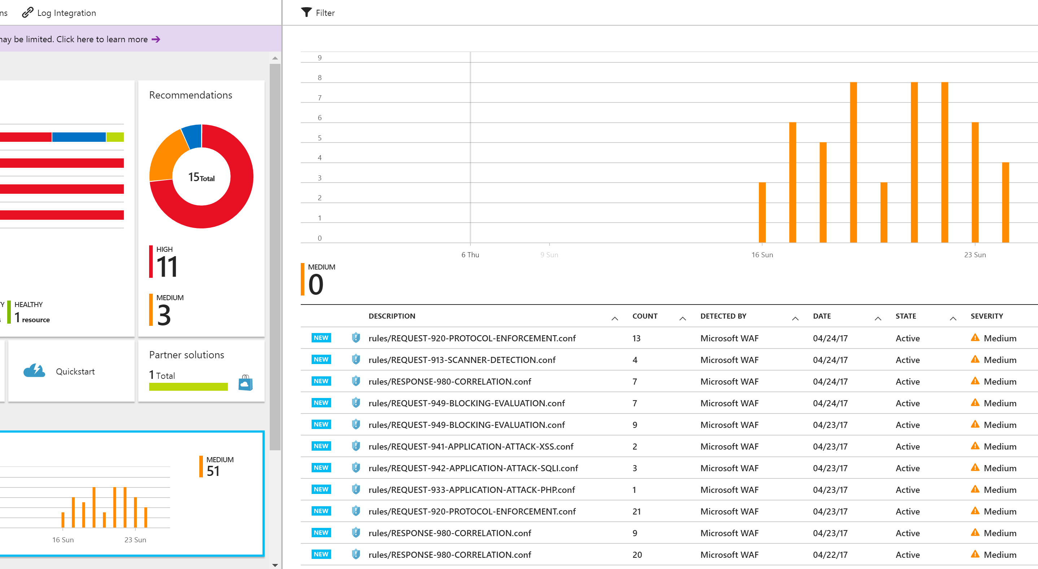
Monitor intrusions
Event Hub
Enable WAF log via Azure Monitor
Real time logs to monitor attacks
WAF logs integrated with:
Customer storage account in JSON format
Event Hub
OMS Log Analytics enabling search
Azure Security Center Integration
WAF
Azure Storage
Azure
Monitor
OMS Log Analytics
REST API
WAF log
Third party
tools

Slide 38
Load balancing scenarios
DNS
Traffic
Manager
Load Balancer
Application Gateway / WAF
Load Balancer
DB
DB
DB
DB
DB
DB
DB
DB
REGION A
REGION B
Scalable
Redundant
Scalable
Redundant
+ Protection
+ Global
with multiple
Azure Regions

Slide 39

Traffic Manager

Slide 40

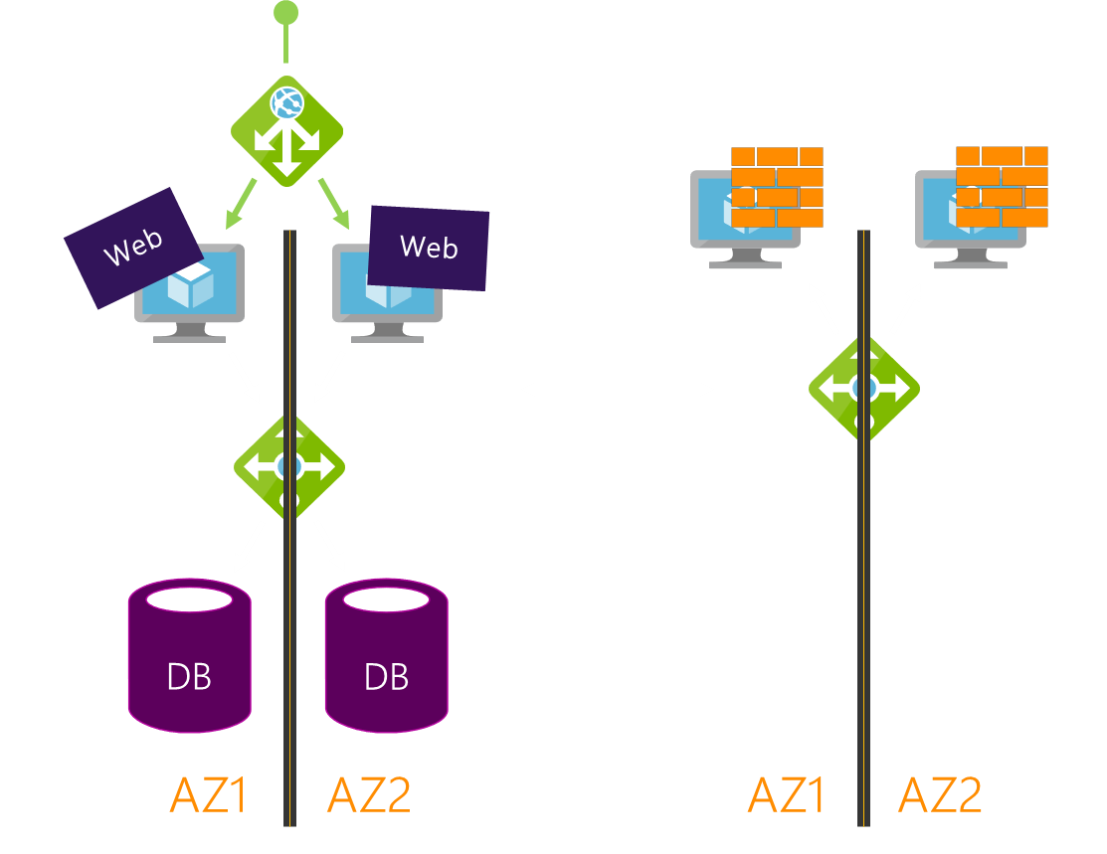
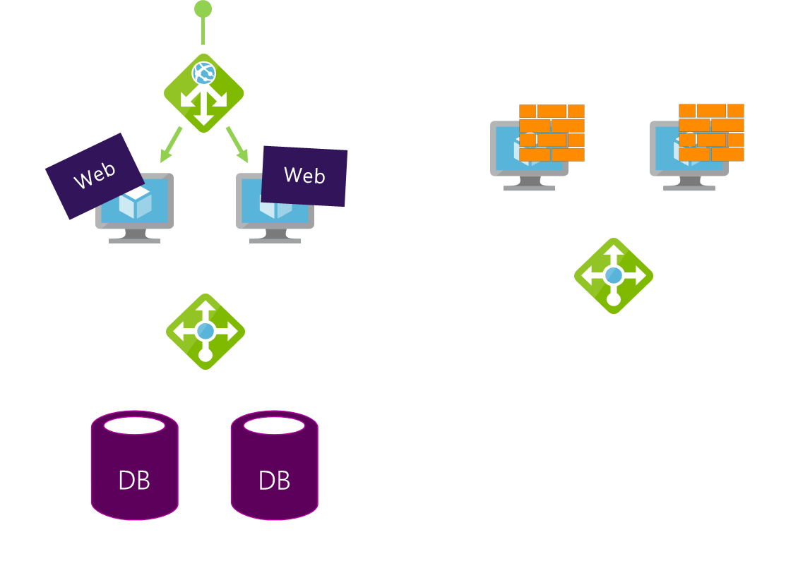
Global Resiliency & Performance with DNS
Easy Onboarding
Multiple Routing Methods
  Endpoint monitoring
  High resiliency
?
Traffic Manager

Slide 41

Traffic Manager Routing Methods
Priority
Traffic Manager
Priority 1
Priority 2
Priority 3

Slide 42
Traffic Manager Routing Methods
Priority
Traffic Manager
Weighted Round Robin
Central US
1%
West US
49%
East US
50%

Slide 43
Traffic Manager Routing Methods
Priority
Weighted Round Robin
Geographic

Slide 44
Traffic Manager Routing Methods
Priority
Weighted Round Robin
Geographic
Performance

Slide 45

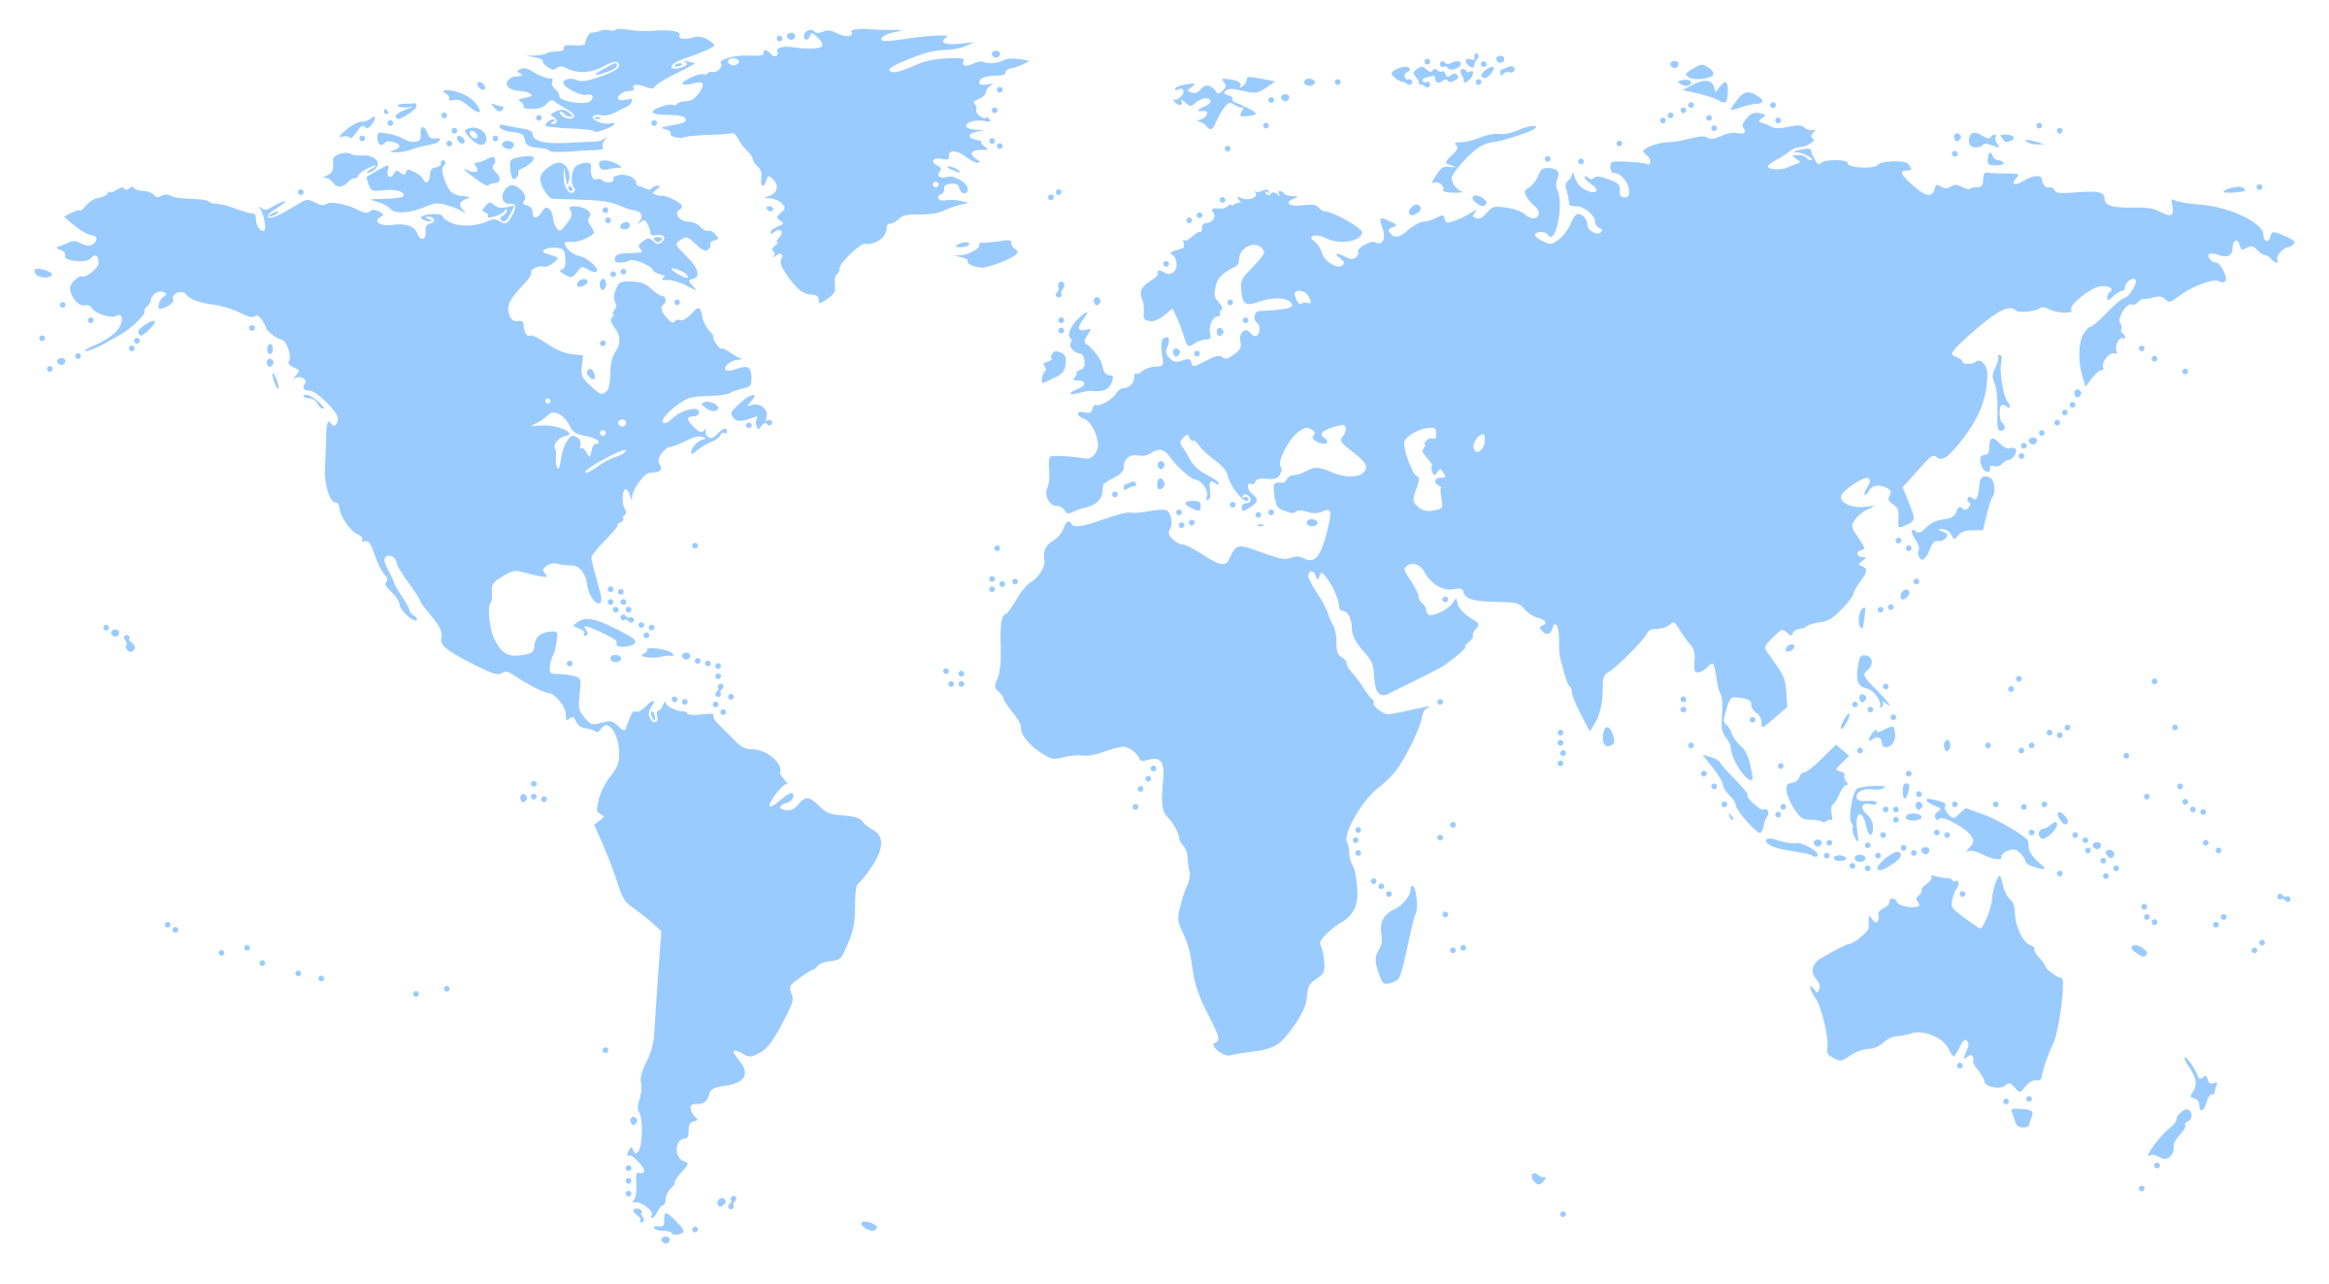



Traffic Manager Real User Measurements
Increased accuracy in routing decisions by leveraging Real User Measurements (RUM) taken from where your end users connect from
Latency metrics are obtained from your customer base ensuring that all end users networks relevant to you are covered
Integration with Visual Studio Mobile Center
NEW

Slide 46
Traffic Manager Routing Methods
Priority
Parent Profile - Performance
Weighted Round Robin
Geographic
Child Profile – Weighted RR
Performance
East Asia
East US
West Europe
Nested
5%
95%
West Europe 1
West Europe 2

Slide 47
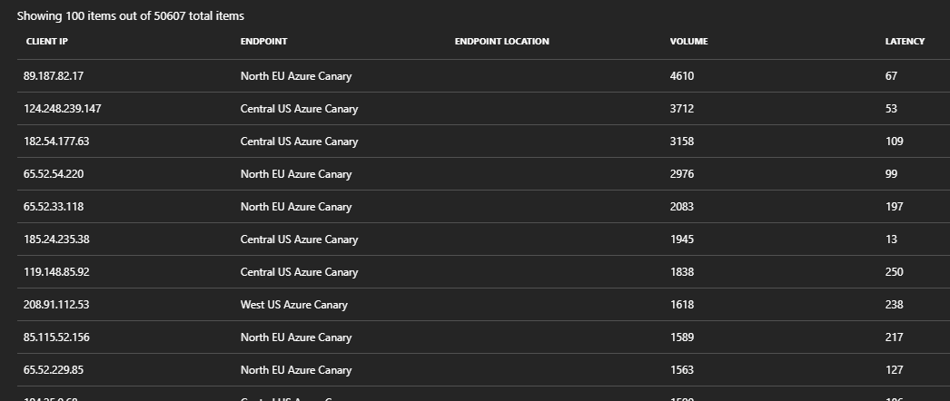
Traffic Manager—Traffic View
Understand the volume of traffic generated by your users and the latency experienced by them, at a per region level
Deep dive into traffic flow patterns from a specific region
NEW

Slide 48
Demo
Traffic Manager + Application Gateway

Slide 49
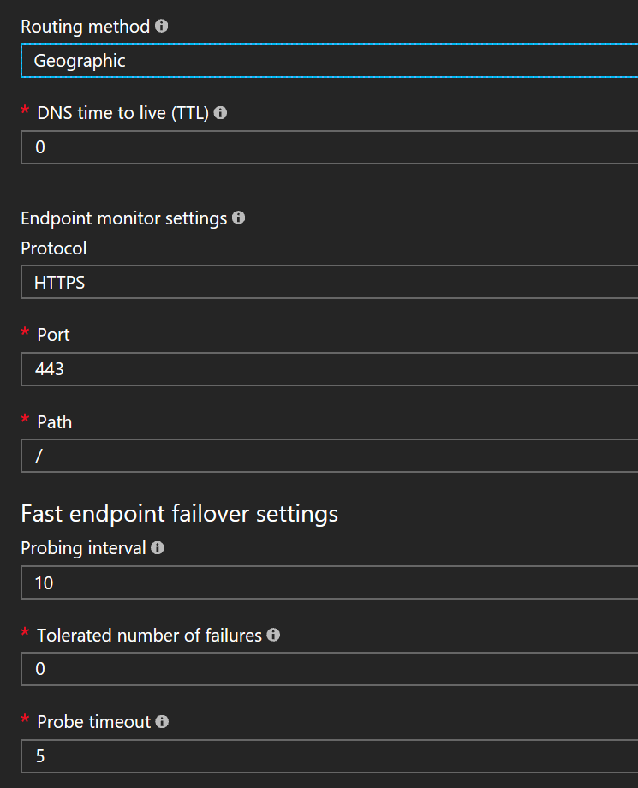
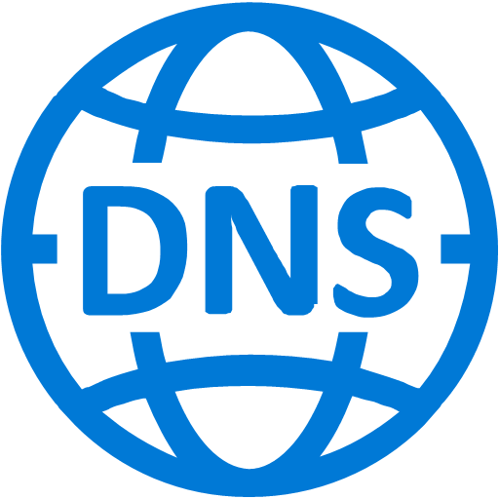
Demo Config
www.AzIgniteDemo.com
Traffic Manager Geographic
Rest of the World
Azure DNS
Traffic Manager Performance
Singapore
AppGW
AppGW
AppGW
North Europe
Japan East
Central US
West Europe 1
West Europe 2

Slide 50

Symantec:
Journey with Azure
Mike Shavell
Architect/Technical Director
Symantec

Slide 51
Norton Cloud Services
Reputation
  3+ Billion Endpoint Requests a Day
  File, Website, Mobile, and More
  Endpoint Telemetry
  Messaging
  2+ Billion Endpoint Requests a Day
  Notification, Message Bus, and Communication
  Cloud to Cloud
  Management
  Endpoints & Appliances
  Policy, Events, and Registration

Slide 52
Traffic Manager
  Service
  All Norton Services
  Including internal communication
Scale
  Routing 150+ million endpoints (clients)
  1+ Billion Queries / Month
Reliability & Performance
  100% Uptime
  Worldwide DNS Presence for Low Latency
East
Endpoints
TM
West

Slide 53
SPOC & ALB
  Service
  Single Point of Contact
  Endpoint Notification
  Multi Region
Scale
  39k Requests / Second
  2+ Billion Requests / Day
  10-20 million concurrent connections
  Average time to service request < 2ms
Azure
  Traffic Manager Balance 50/50 (normal)
  No more RR DNS
  Eliminated Public IP needs
  4-30 minute Long Polling
SPOC
Long Poll
ALB
HTTPS

Slide 54
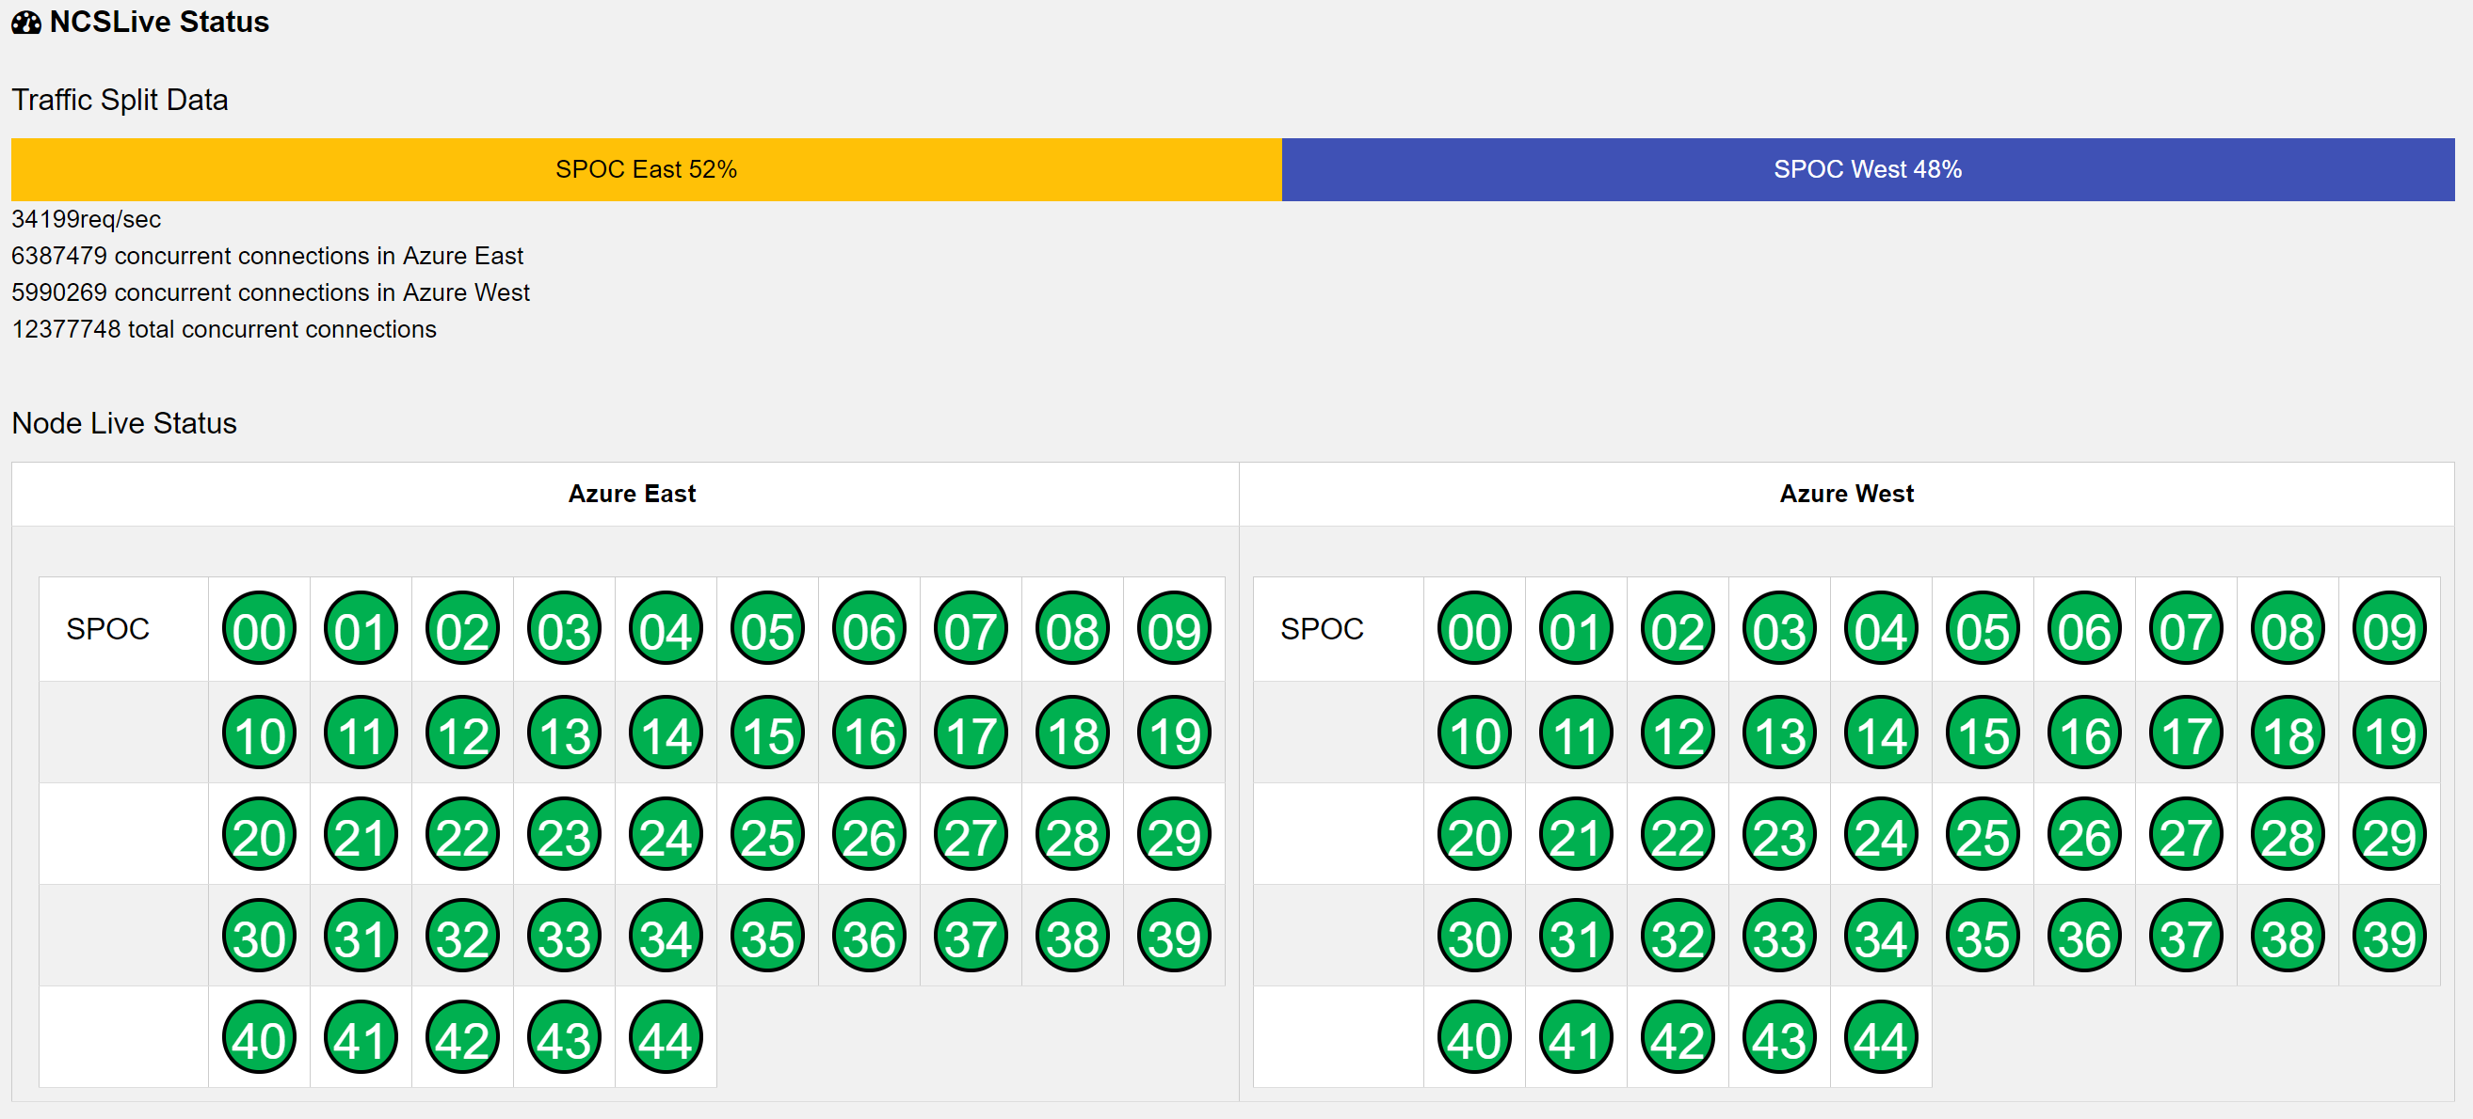
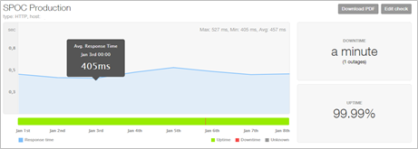
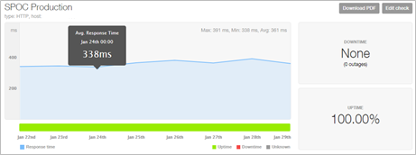
ALB Scale & Performance
  Success Story
  US Based Regions
  ~60ms reduction in latency (worldwide)

Slide 55
Shasta and Application GW
RRS
  Service
  File Reputation
  Protection for Norton & Symantec Endpoints
  Multi Region
Scale
  25k Requests / Second
  1.5+ Billion Requests / Day
  2ms Service -> App GW Response Latency
  Maximum worldwide response < 5s
Azure
  Leverage Application GW
    Hardware in DC’s vs Managed Service
    Virtual Appliances
HTTPS
App
Gateway
HTTP

Slide 56
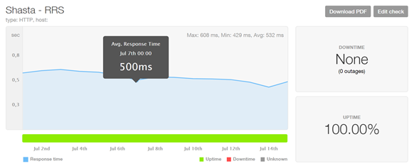
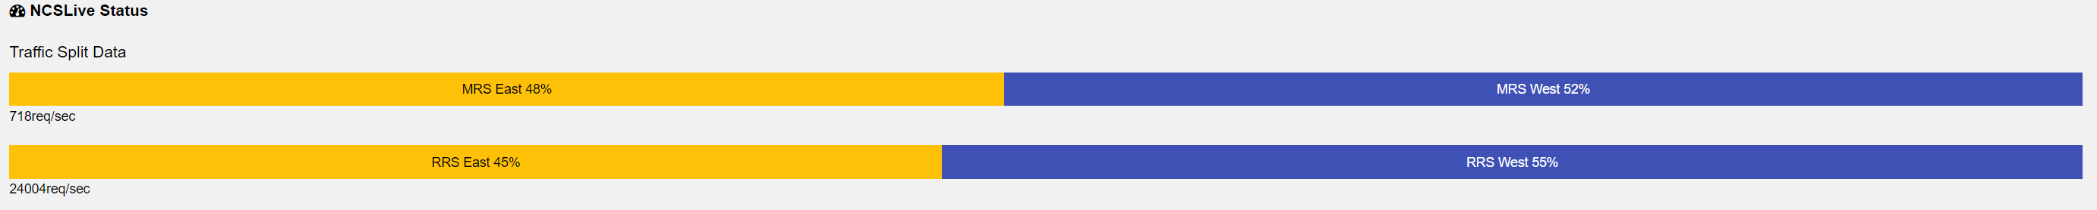
Application GW
  Our Design
  Traffic Manger Control
  Up to 6 APP GW’s / Region
    East / West US
    Up to 25 instances in each
    All SSL termination
  Auto Scale
  What's Next?
  Performance Routing Traffic Manger & Amsterdam

Slide 57
Azure Networking at Ignite
Code | Title | Day and time | Location
BRK4032 | Monitoring, diagnosing and debugging with Azure networking | Friday 9:00 am | Hyatt Regency Windermere Y

Slide 58
Please evaluate this session
From
your
Please expand notes window at bottom of slide and read.
Then Delete this text box.
PC or tablet: visit MyIgnite https://myignite.microsoft.com/evaluations
Phone: download and use the
Microsoft Ignite mobile app https://aka.ms/ignite.mobileapp
Your input is important!

